Slide 1

2026-27 PROPOSED BUDGET

Slide 3

How Does Trailer Estates Get the Money to Fund the Budget?

Slide 4
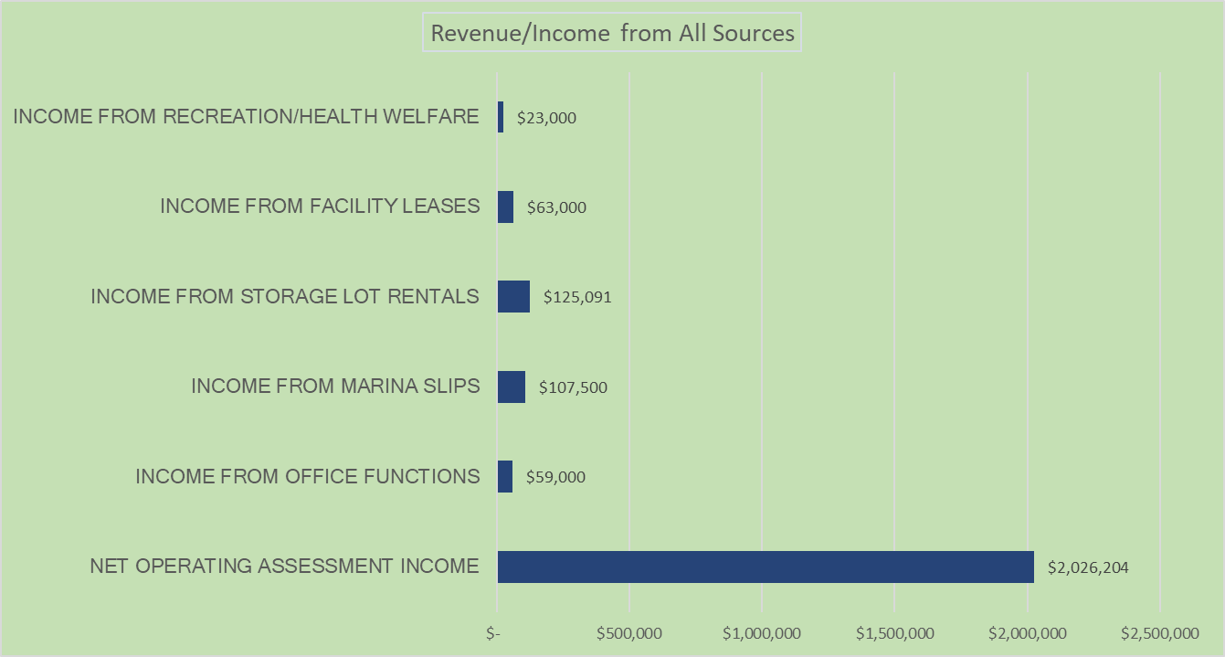
Where does the Money Come from to Operate Trailer Estates?

Slide 5

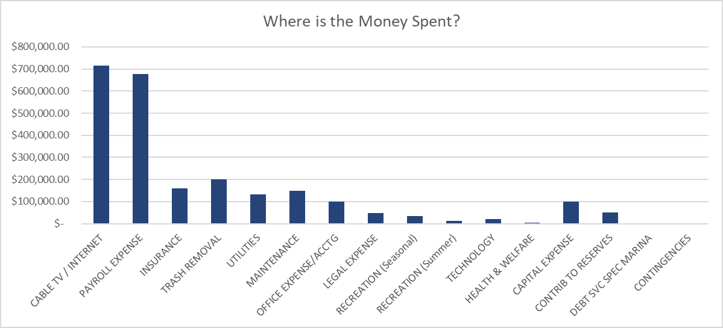
Where Does the Money Go? (Expenditures)

Slide 6

Trailer Estates Park and Recreation District Hurricane Insurance Claims Recap
Trailer Estates Park and Recreation District
Hurricane Insurance Claims Recap
Income
43700 · Hurricane Claim Payments
FIA Property Claims #100123926 Debbie/Electrical Storm $33,408.99
FIA Property Claims Ck# 2864 Milton $109,014.32
FIA Property Claims Ck# 2870 Helene $117,951.70
Total Insurance Reimbursement $260,375.01
Expense
54599 · Insurance Claim Expense $380,493.23
Total Expense $380,493.23
Net Cost to the District (To Date) -$120,118.22
43700 · Hurricane Claim Payments
FIA Property Claims #100123926 Debbie $ 33,408.99
FIA Property Claims Ck# 2864 Milton $109,014.32
FIA Property Claims Ck# 2870 Helene $117,951.70
Total Insurance Reimbursement $260,375.01
54599 · Insurance Claim Expense $380,493.23
Total Expense $380,493.23
Net Cost to the District (To Date) -$120,118.22

Slide 7

Hurricane Costs
What Didn’t Insurance Cover?
Debris Removal – FEMA picked up 2/3rd of the total debris, TE picked up 1/3rd. Cost was approx. $60,000.
Hurricane Damage generally has deductibles. TE could not cover the deductible on many buildings with high valuations like the Office & Halls complex, the Activity Center, etc.
The majority of damage was centered around the new Maintenance & Treasure Barn complex.

Slide 8
Comparable Special District Assessments
Special District | Assessment Amount | Annual or Monthly
Tri-Par Estates | $1648 (Current Budget) | Annually
Trailer Estates | $1469 (Proposed) | Annually
Holiday Park | $2340 (Current Budget) | Annually

Slide 9

We Put Your Money to Work!
Interest Earned October 2024-September 2025
$57,838.00

Slide 10

2026-27 BUDGET SUMMARY
The proposed assessment amount is $1469.15 per year for a single lot.
This works out to $122.43 per month!
The assessment includes Cable TV, High-Speed Internet, Curbside Trash Pickup, and all the Amenities.

Slide 11


Budget Adoption –Timeline
(subject to change)
Trailer Estates Park & Recreation District
2026/2027 Budget Calendar
2/17/26 | Board Workshop 9:30am – Budget Kick-Off Discussion- Capital Outlay Projects
3/3/26 | Board Workshop Discuss Proposed Budget – PowerPoint
3/17/26 | Board Workshop 9:30am Discuss Proposed Budget Finalize Proposed Budget/Assessment O & M Approve Public Hearing Meeting on April 21, 2026 Publish Notices in Newspaper, Website, and TE Bulletin Boards Commence Sending Mailed Notice to Property Owners
4/21/26 | Board Meeting 9:30am Public Hearing on Budget/Assessment O & M Board Meeting Adopt Budget/Assessment for Fiscal 2026-27 Publish Financial Statement in Newspaper, Website, and TE Bulletin Boards

Slide 12
Budget Adoption –Timeline
(subject to change)
Interim Schedule:
Set public hearing/adoption date for 4/21/26 by Notice
Post Proposed Budget on public bulletin board.
Add proposed budget to Trailer Estates website.
Mail Proposed Budget/Financial documents to owners’ week of 3/17 5. Publish Public Hearing/Budget Adoption Date Notice in local newspaper 3/20
6. Publish Budget and Financial Statement in June Newsletter.
4/21/26 Regular Board Meeting – Public Hearing / Adopt Budget/Assessment
If Approved:
Notify Tax Collector of amount of Assessment Add Approved Budget documents to website.
Marina Special Assessment will require re-authorization in June 2026

Slide 13

Budget Process According to the Charter
Section 7. The trustees shall have the right, power, and authority to levy a special assessment known as a recreation District assessment against all taxable real estate situated within said District for the purpose of providing funds for the operation of the District. The trustees shall, in accordance with general law, by resolution, fix the amount of the assessment for the next ensuing fiscal year on or before June 1st of each year and shall direct the tax assessor of Manatee County to assess and the property appraiser Manatee County to collect such assessment as assessed upon each residential parcel or platted subdivision lot or proportionate share thereof within the District.
Prior to the adoption of the resolution fixing the amount of the assessment, the trustees shall hold a public hearing at which time property owners within the District may appear and be heard. Notice of the time and place of the public hearing shall be published once in a newspaper of general circulation within the county at least 21 days prior to the public hearing.
The county property appraiser and tax collector shall include on the Manatee County tax roll the special assessment for the District benefits thus made by the trustees of the District, and the same shall be collected in the manner and form as provided for collection of county taxes. The county tax collector and the county property appraiser shall each receive compensation for their services regarding such special assessment of 1-1/2 percent of the gross tax receipts instead of the commissions and fees usually earned for the assessment and collection of county taxes. Further, the services of the property appraiser and the tax collector under this charter are hereby declared to be special services performed directly for the District, and any payment therefor shall not be considered of the general income of such official nor come under sections 116.03 and 145.121, Florida Statutes.
After deducting therefrom the said fees, the tax collector shall deposit the funds into a depository designated by the trustees of the District for the account of the District. For the purpose of determining property subject to the District assessment, a "residential parcel" shall be construed to mean a parcel, as identified by the property appraiser of Manatee County, or a platted subdivision lot or a proportionate share thereof as of January 1 of the taxable year. The District assessment shall not be an ad valorem tax but rather shall be an assessment assessed equally against all residential parcels or platted subdivision lots of record thereof.

