Slide 1
2025-26 PROPOSED BUDGET

Slide 2
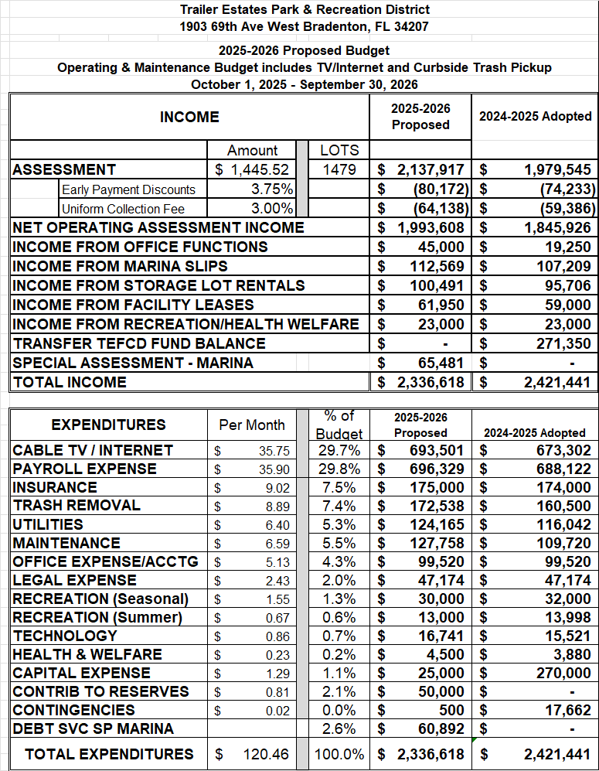

Slide 3
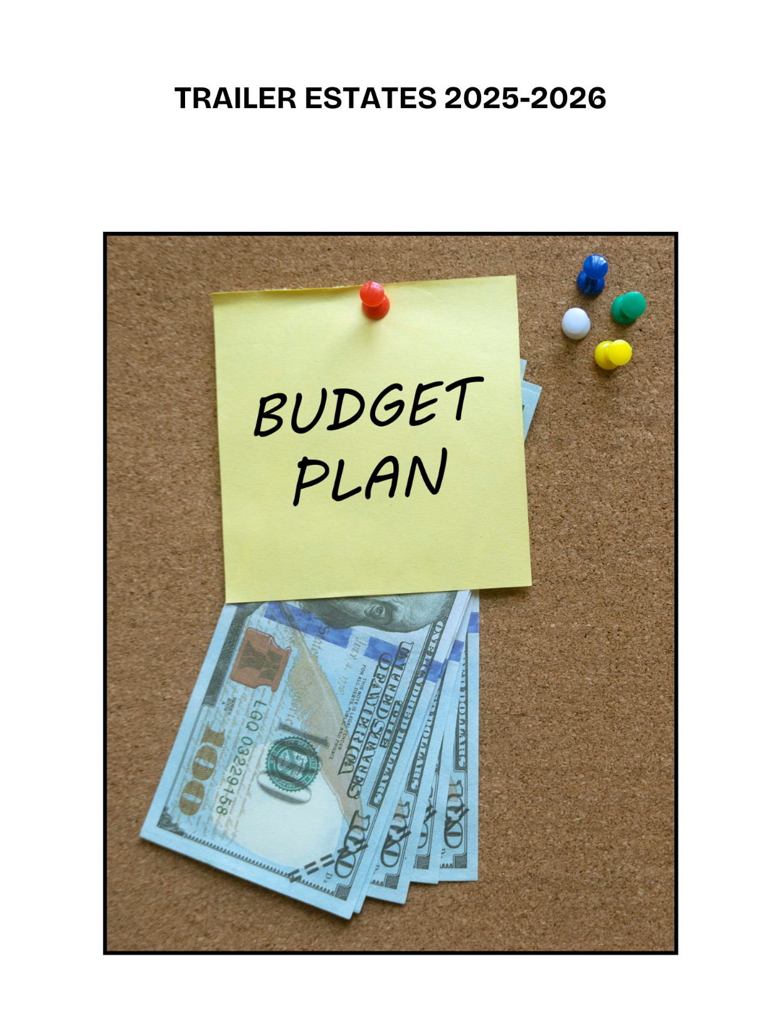
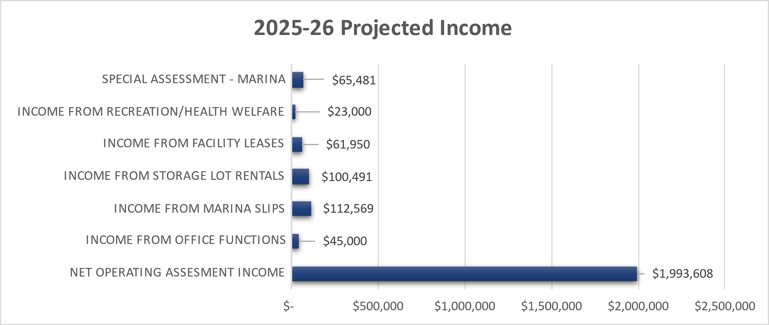
How Does Trailer Estates Get the Money to Fund the Budget?

Slide 4
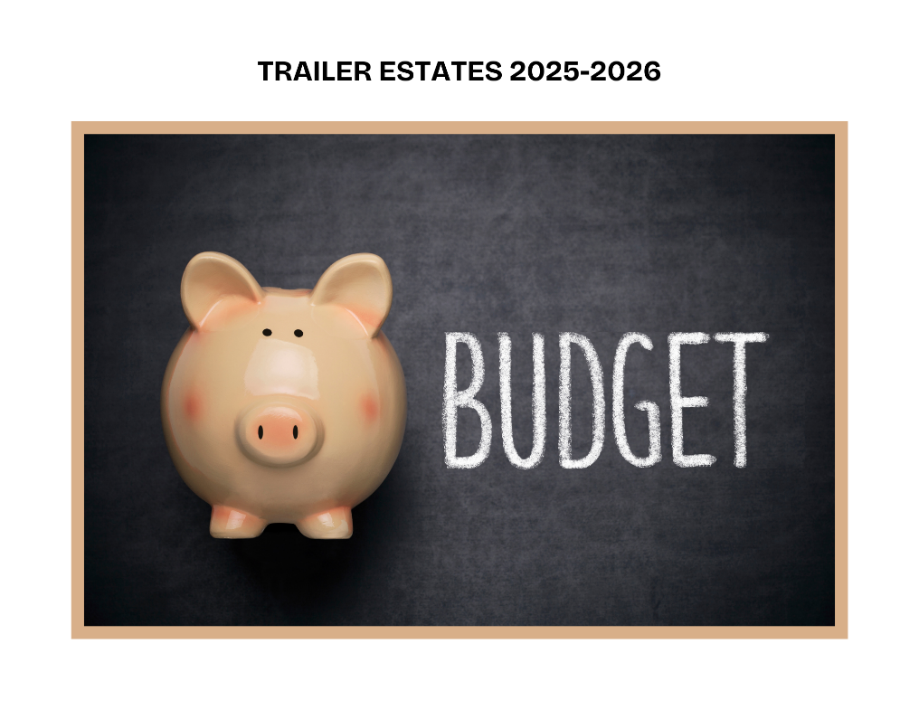
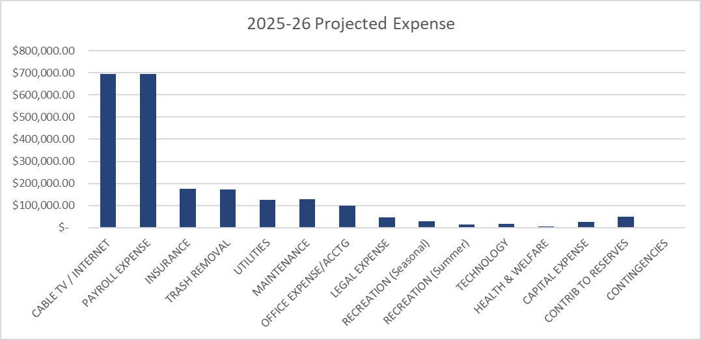
Where Does the Money Go? (Expenditures)

Slide 5
Within 2025-26 Budget Important Contracts Expiring
Contract | Details
Curbside Trash Pickups, Dumpsters for Recycling, Trash, and Yard Waste. Contract with Waste Pro Ends 3/31/2026 | Current Contract Cost - $173,000Yr Contract Cost 2024-25 - $250,000 (Hurricanes) Options- 1. Switch To County Curbside Pickups of All Waste 2. Rebid Current Contract As-Is 3. Rebid Contract Without Dumpsters
Laundromat – Washing Machines and Dryers Contract with Washco (Caldwell/Gregory) Ends 5/28/2026 | Current Contract Value (Revenue) - $3900/Yr Options- Try and Renew Contract (Unlikely) Eliminate Laundromat-Use New Laundromat at Corner in Plaza – Easy Access by Golf Cart
Financial Audit Services Contract with Maudlin Jenkins | Current Contract Value - $+/- $17,500yr Required to Rebid Services

Slide 6
Hurricane Costs Will Linger
Highly unlikely that the FULL cost of repairs from the 3 weather events (Hurricanes) in 2024 will be finalized before this budget. They will spill over into this upcoming budget.
Insurance Payments will still be coming in as settlements occur.
Insurance coverages may be harder to get and afford.

Slide 7
Capital Outlay Will be Limited in 2025-26
Projected at $25,000 to cover anything unanticipated which requires Capital Replacement.
Capital Outlay was drastically reduced until the complete costs of the hurricanes are satisfied and analyzed.

Slide 8
Comparable Special District Assessments
Special District | Assessment Amount | Annual or Monthly
Tri-Par Estates | $1584 (Current Budget) | Annually
Trailer Estates | $1445 (Proposed) | Annually
Holiday Park | $2340 (Current Budget) | Annually

Slide 9
We Put Your Money to Work!
Interest Earned October 2023-September 2024
$60,628.00

Slide 10
Contribution to Reserves
We are including $50,000 in the expense column to go back into our reserves.
This will start to replenish the money spent from reserves to pay for hurricane expenses.
Insurance proceeds will also be used to pay back the reserves.

Slide 11
2025-26 BUDGET SUMMARY
The proposed assessment amount is $1445.52 per year for a single lot.
This works out to $120.46 per month!
The assessment includes Cable TV, High-Speed Internet, Curbside Trash Pickup, and all the Amenities.

Slide 12
Budget Adoption –Timeline (subject to change)
2025/2026 Budget Calendar
2/18/25 Board Workshop 9:30am
Present Proposed Budget/Assessment documents and financials
3/4/25 Board Meeting (Following Workshop)
Set Public Hearing/Assessment date for 4/15/25 Board Meeting
3/18/25 Board Workshop 9:30am
Finalize Proposed Budget/Assessment
4/15/25 Board Meeting 9:30am
Public Hearing on Budget/Assessment
Adopt Budget/Assessment for Fiscal 2025-26

Slide 13
Budget Adoption –Timeline (subject to change)
2025/2026 Budget Process
1. Set public hearing/adoption date for 4/15/25 at regular Trustee Board meeting.
2. Post Proposed Budget on public bulletin board.
3. Add Proposed Budget to Trailer Estates website.
4. Mail Proposed Budget/Financial documents to owners the week of March 10.
5. Publish Budget Adoption Date Notice in local newspaper week of March 10.
6. Publish Notice, Proposed Budget and Financial Statement in May Newsletter.
If Approved:
Notify Tax Collector of amount of Assessment.
Add Approved Budget documents to website.

Slide 14
Budget Process According to the Charter
Section 7. The trustees shall have the right, power, and authority to levy a special assessment known as a recreation District assessment against all taxable real estate situated within said District for the purpose of providing funds for the operation of the District. The trustees shall, in accordance with general law, by resolution, fix the amount of the assessment for the next ensuing fiscal year on or before June 1st of each year and shall direct the tax assessor of Manatee County to assess and the property appraiser Manatee County to collect such assessment as assessed upon each residential parcel or platted subdivision lot or proportionate share thereof within the District.
Prior to the adoption of the resolution fixing the amount of the assessment, the trustees shall hold a public hearing at which time property owners within the District may appear and be heard. Notice of the time and place of the public hearing shall be published once in a newspaper of general circulation within the county at least 21 days prior to the public hearing.
The county property appraiser and tax collector shall include on the Manatee County tax roll the special assessment for the District benefits thus made by the trustees of the District, and the same shall be collected in the manner and form as provided for collection of county taxes. The county tax collector and the county property appraiser shall each receive compensation for their services regarding such special assessment of 1-1/2 percent of the gross tax receipts instead of the commissions and fees usually earned for the assessment and collection of county taxes. Further, the services of the property appraiser and the tax collector under this charter are hereby declared to be special services performed directly for the District, and any payment therefor shall not be considered of the general income of such official nor come under sections 116.03 and 145.121, Florida Statutes.
After deducting therefrom the said fees, the tax collector shall deposit the funds into a depository designated by the trustees of the District for the account of the District. For the purpose of determining property subject to the District assessment, a "residential parcel" shall be construed to mean a parcel, as identified by the property appraiser of Manatee County, or a platted subdivision lot or a proportionate share thereof as of January 1 of the taxable year. The District assessment shall not be an ad valorem tax but rather shall be an assessment assessed equally against all residential parcels or platted subdivision lots of record thereof.

